Slide 1

Prog2590 Group-5
Income Classification Using Machine Learning
Group Members
Harkamal Singh Toor
Harsimranpreet kaur
SaInabou samba camara
Lewis Moura

Slide 2
Problem Overview
Can we predict if someone earns >$50K?
Binary classification using Adult Census dataset
48,842 records, 15 features (age, education, occupation…)
Real-world use: financial services, policy-making

Slide 3
Our Approach
4 Models, 1 Dataset, Best Wins
Logistic Regression — baseline linear model, interpretable, fast
Random Forest — ensemble method, handles mixed data, reduces overfitting
KNN — distance-based, non-parametric comparison
Decision Tree — interpretable rule-based model, fast prediction, rule-based

Slide 4
Dataset Description
Dataset Overview
• 48,842 records | 15 features
• Numerical: age, fnlwgt, education-num, capital-gain, capital-loss, hours-per-week
• Categorical: workclass, education, marital-status, occupation, relationship, race, sex, native-country
• Target: income — <=50K (75%) or >50K (25%)
• Class imbalance: 3:1 ratio

Slide 5
Data Preprocessing
Cleaning & Preparing the Data
• Missing values encoded as '?' → replaced with NaN
• Numerical features → Median imputation StandardScaler
• Categorical features → Mode imputation OneHotEncoder
• Pipeline built with sklearn ColumnTransformer (no data leakage)
• 80/20 stratified split → 23,508 train | 5,877 test samples

Slide 6
Performance Result
Logistic 80.96% 0.9062 0.6813
Regression
Decision 85.13% 0.8985 0.6436
Tree
KNN 84.38% 0.8870 0.6372
Random 85.89% 0.9093 0.6796 ← BEST
Forest
Model Accuracy ROC-AUC F1-Score

Slide 7
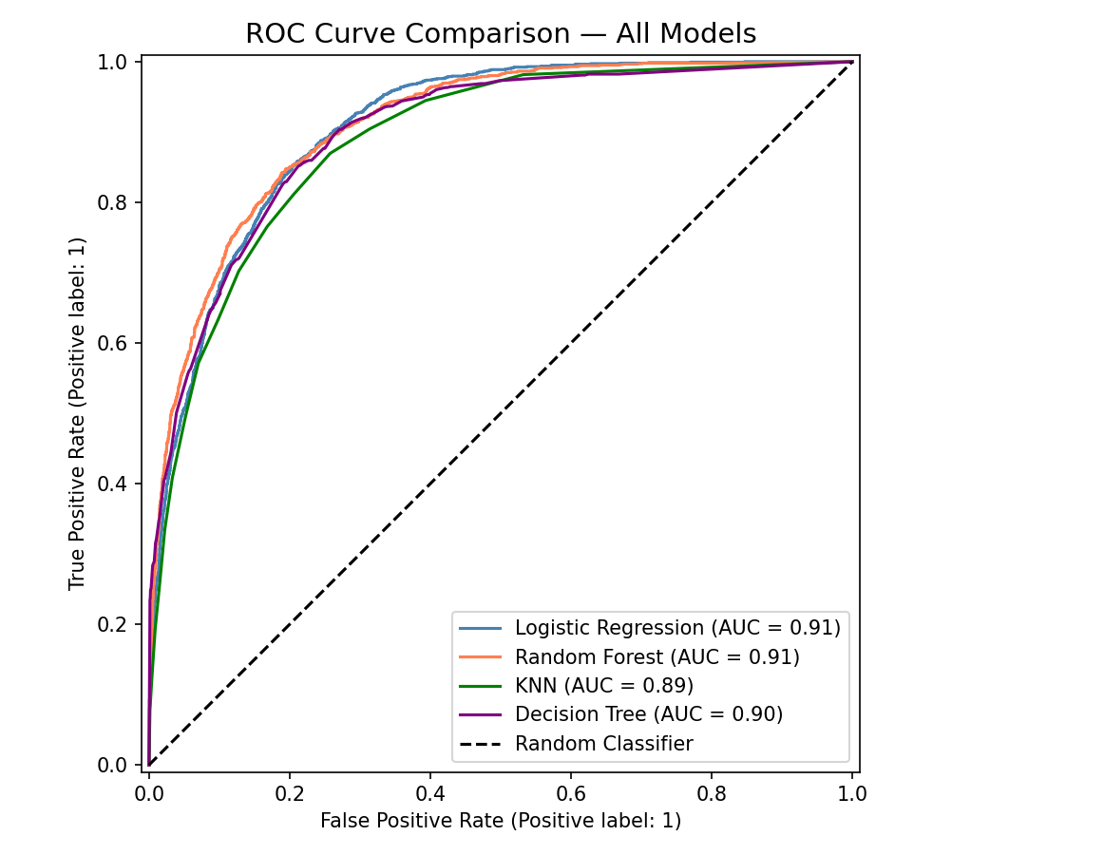
ROC Curve

Slide 8

Precision vs Recall
Precision vs Recall Trade-off
Logistic Regression → best recall (0.8476) catches most >50K cases
Decision Tree → best precision (0.7579) least false positives
Random Forest → best overall balance

Slide 9
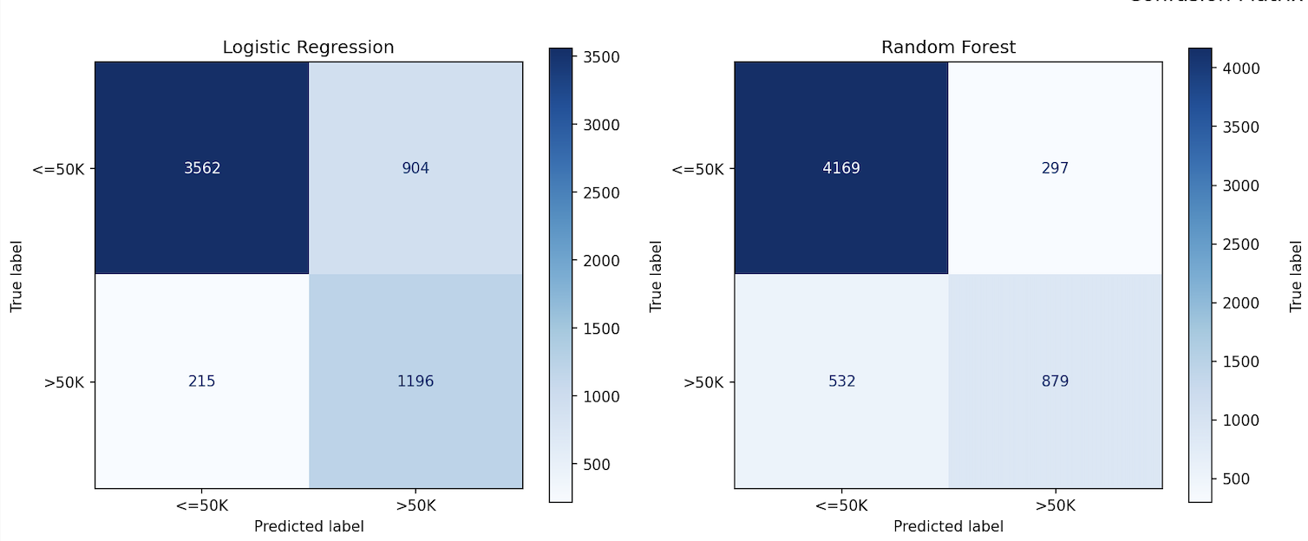
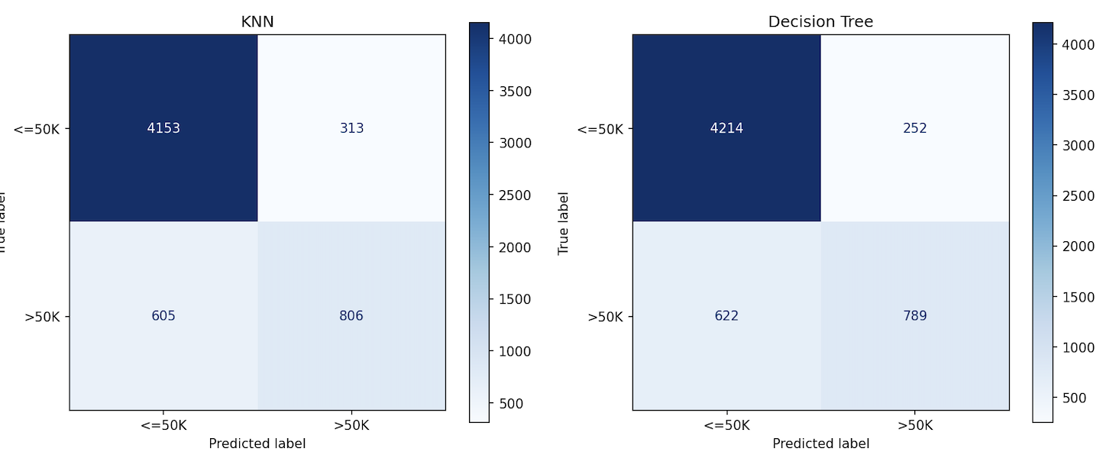
confusion_matrices

Slide 10
Accuracy & ROC-AUC
Random Forest wins on both metrics
Highest Accuracy: 85.89%
Highest ROC-AUC: 0.9093

Slide 11
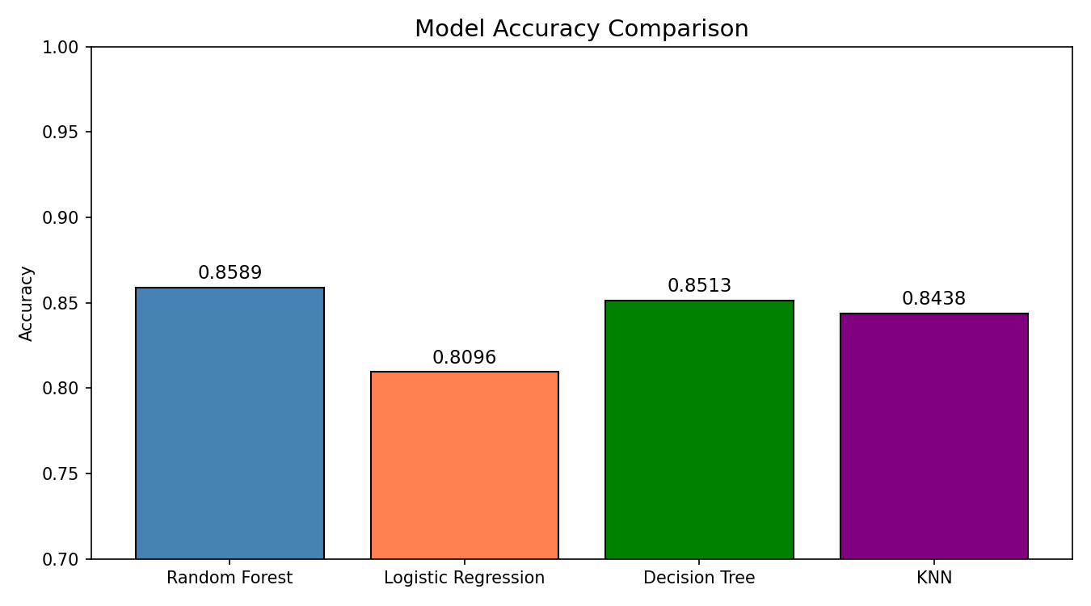

Slide 12
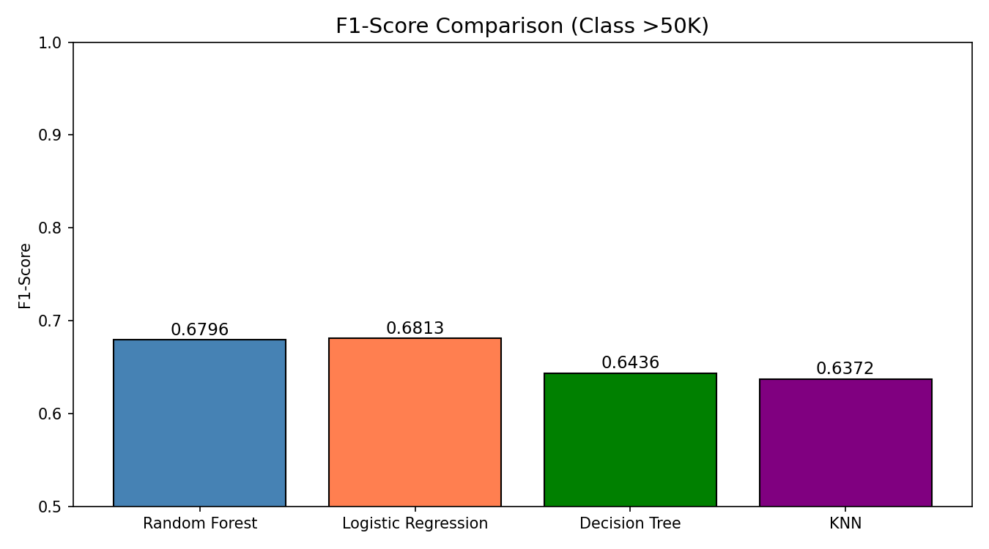

Slide 13
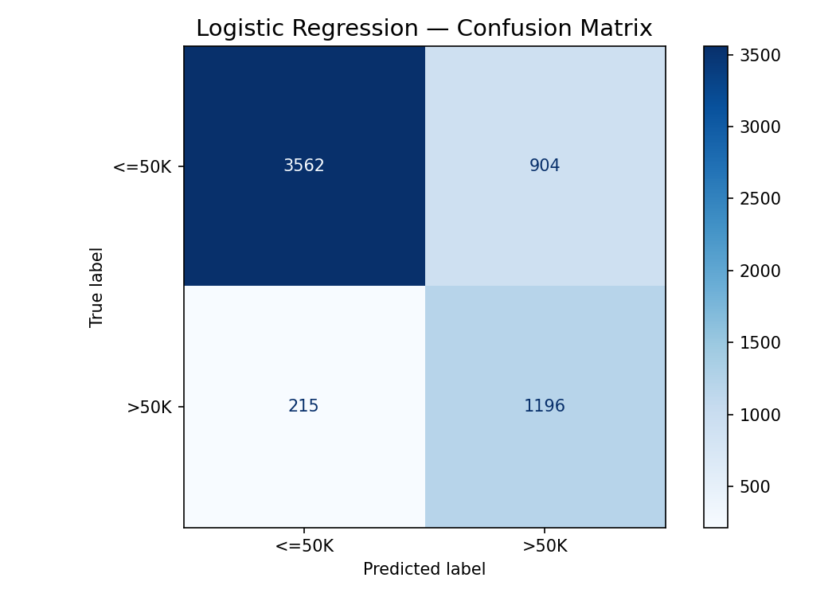
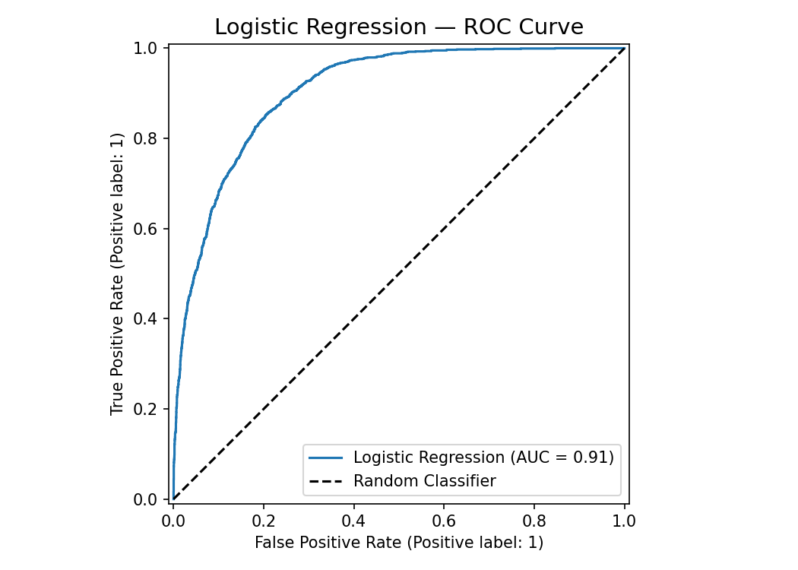

Slide 14
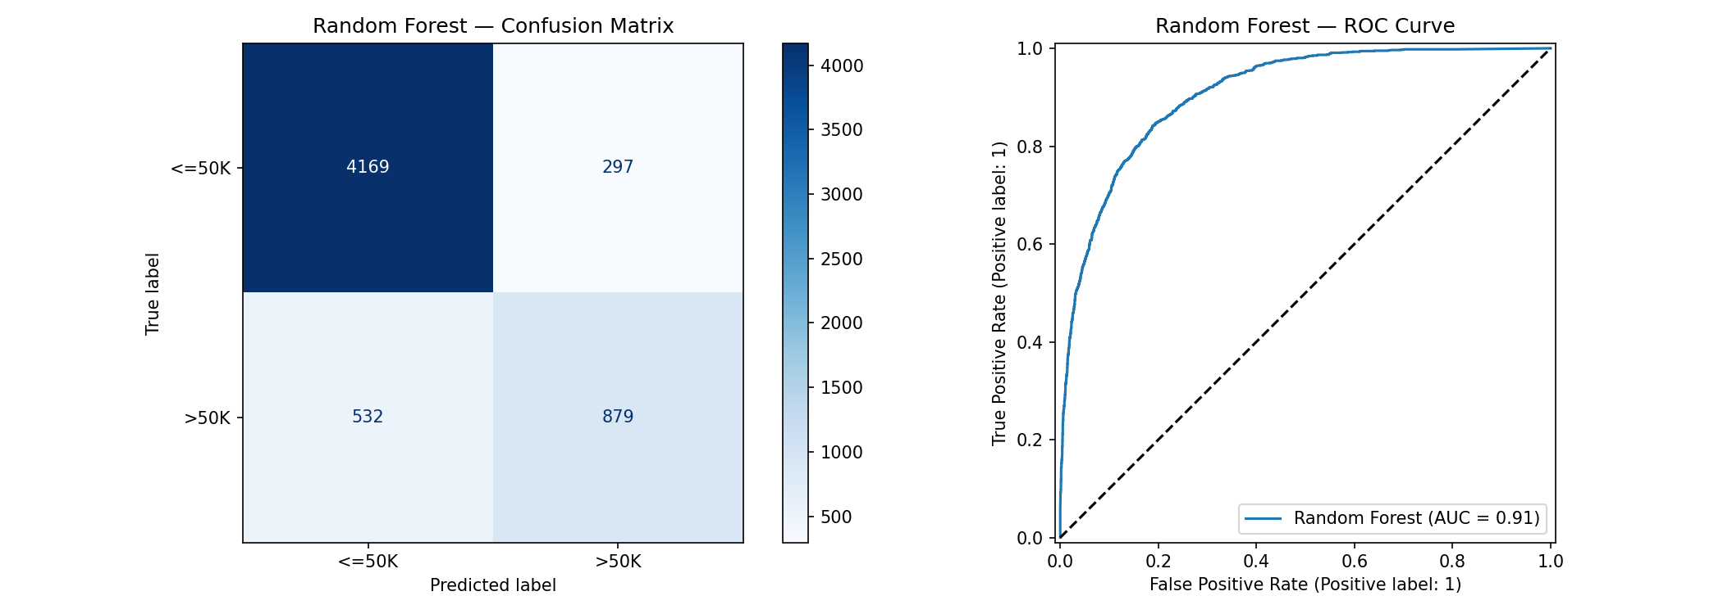

Slide 15
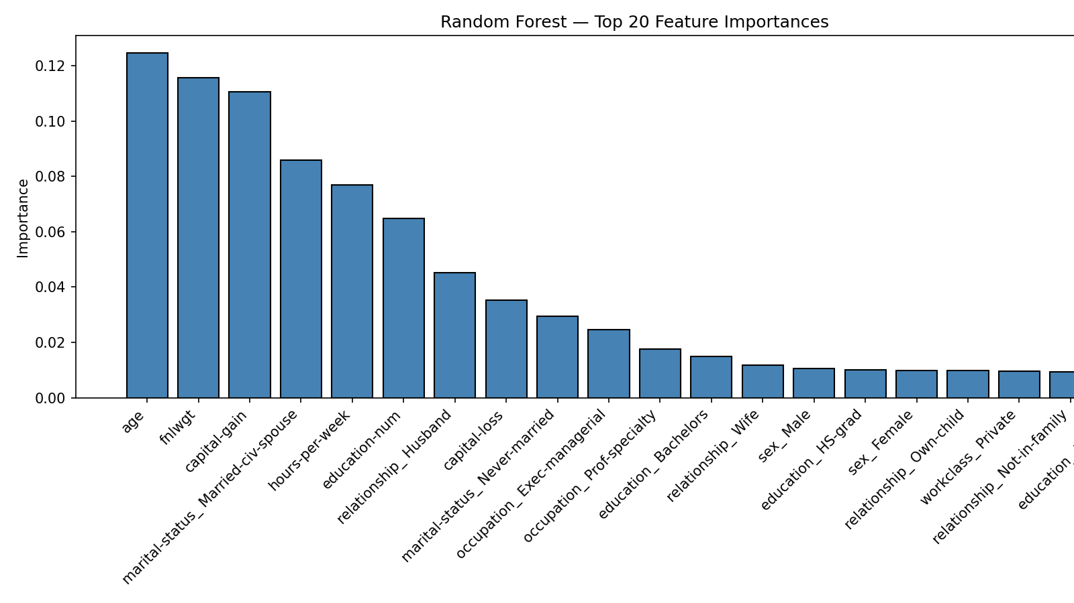

Slide 16


Slide 17
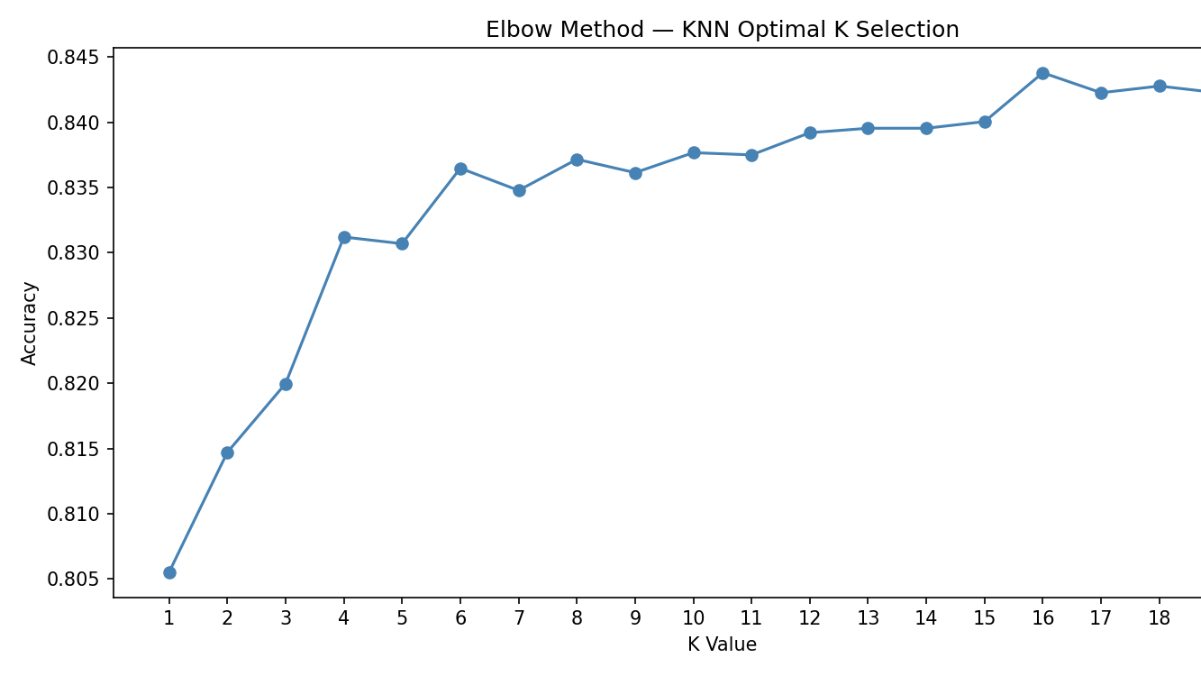

Slide 18


Slide 19
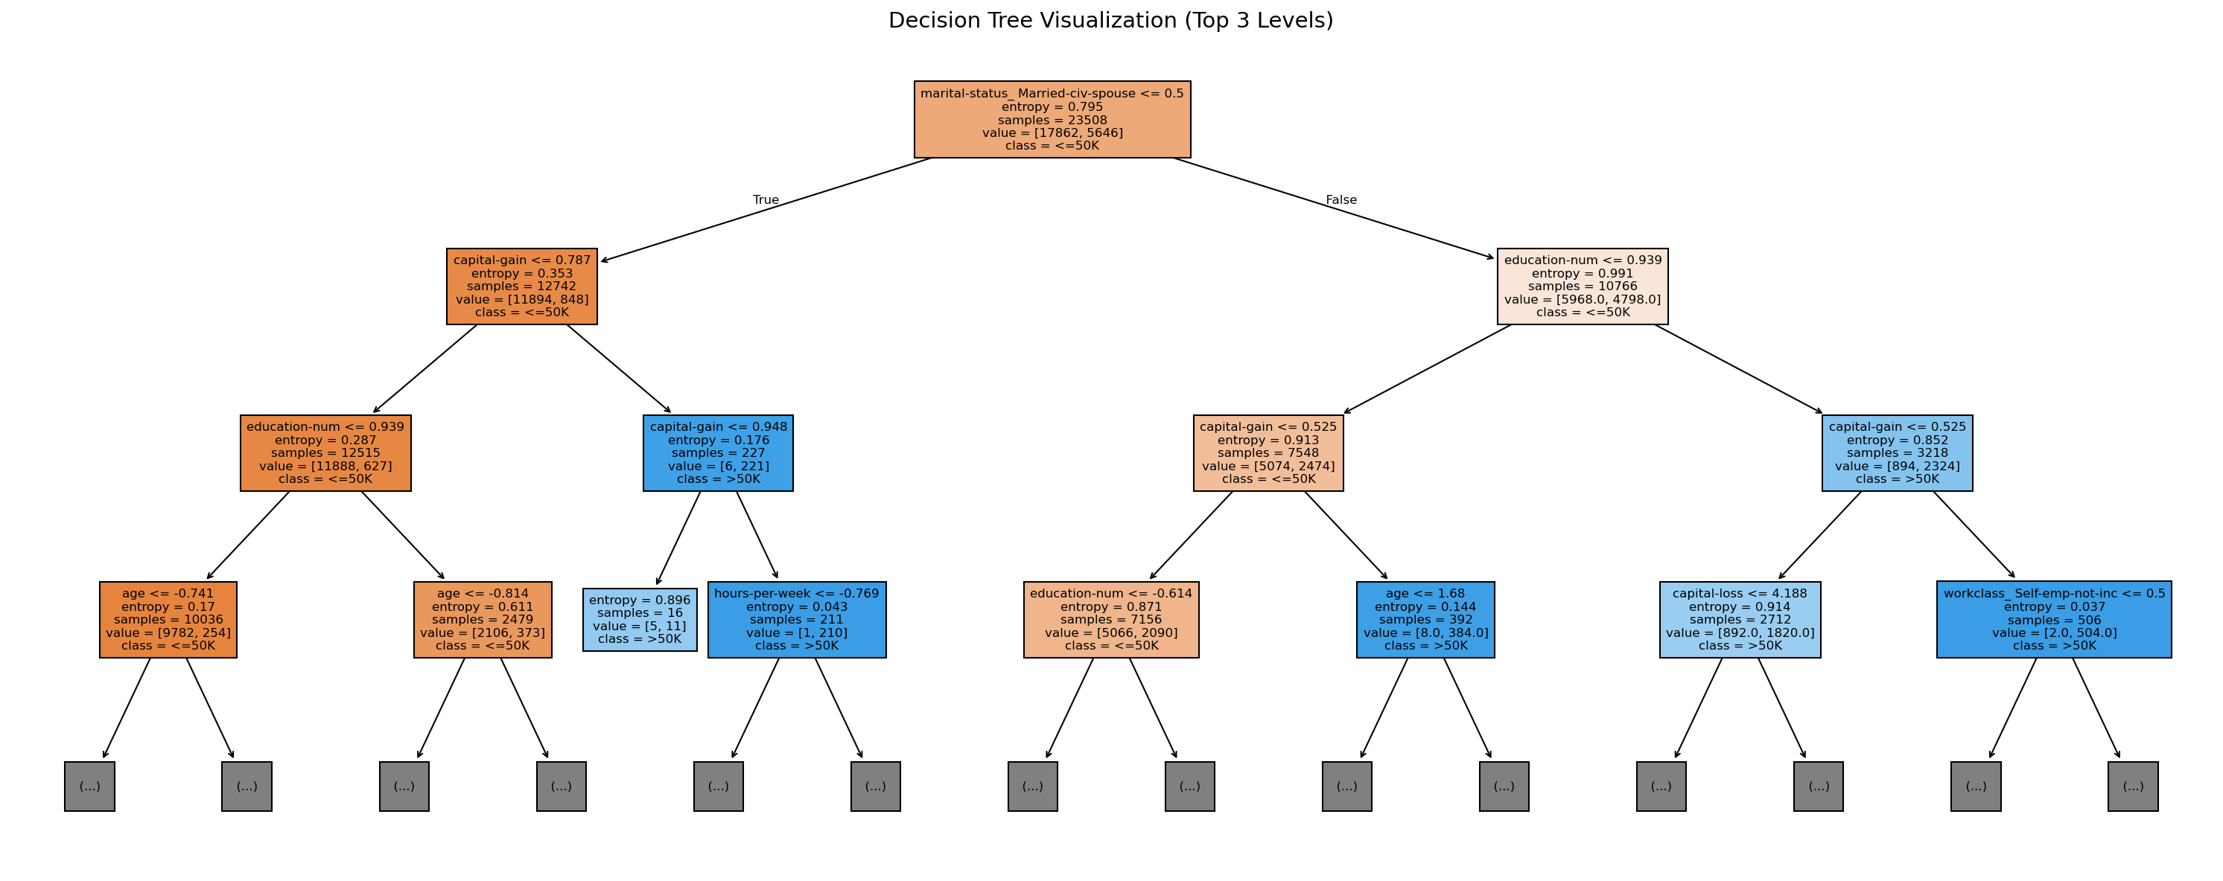

Slide 20
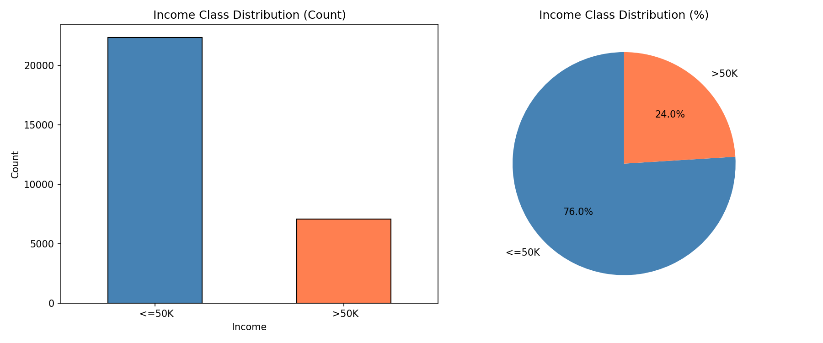
eda_class_distribution

Slide 21
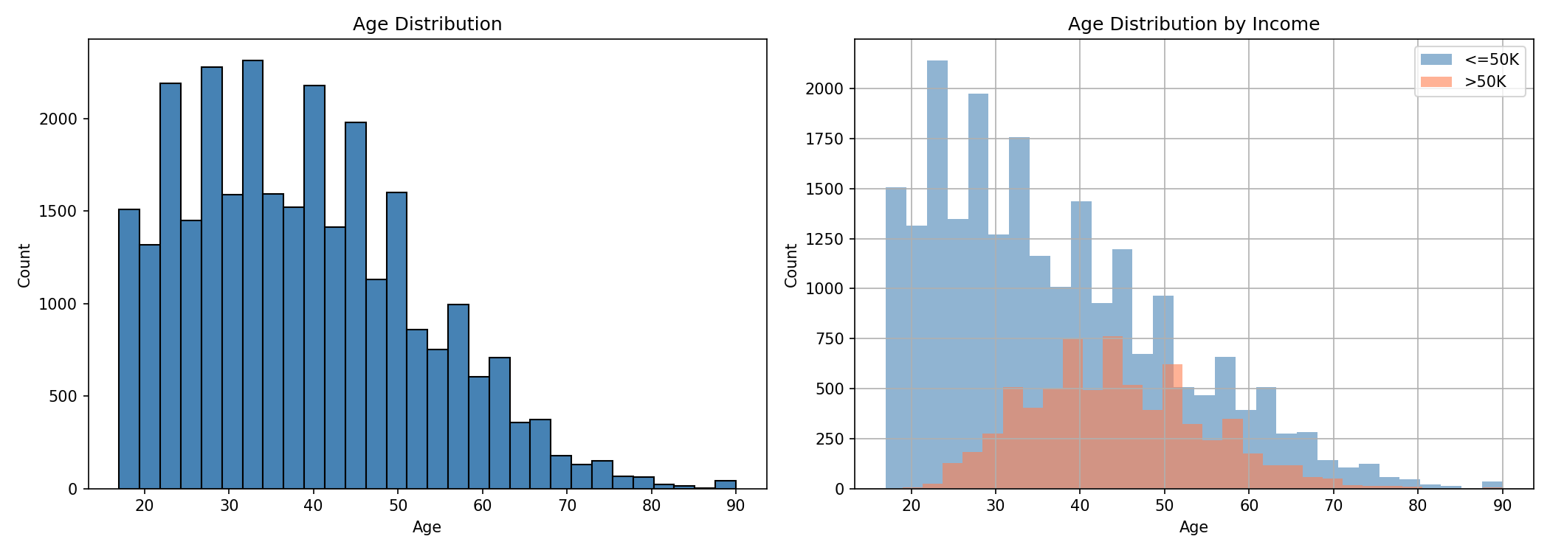
eda_age_distribution

Slide 22
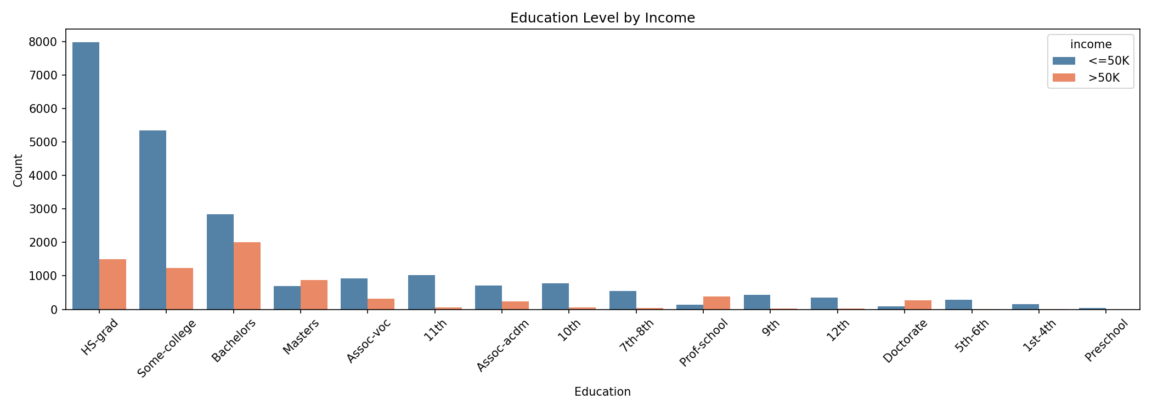

Slide 23
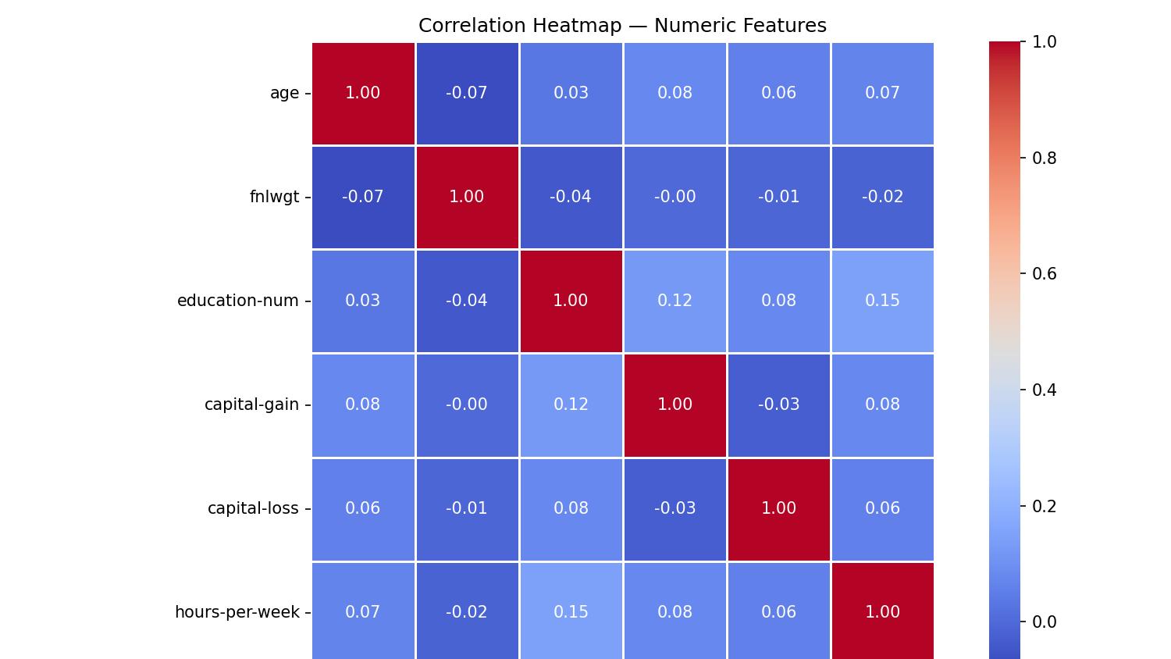

Slide 24
Runtime
Decision Tree is the fastest predictor
Fastest prediction: 0.006s (Decision Tree)
Slowest: 0.25s (KNN — bad for real-time)

Slide 25
Conclusion
Best Model: Random Forest
Highest accuracy (85.89%) + ROC-AUC (0.9093)
Balanced trade-off between speed and performance
Use Logistic Regression if recall matters most

Slide 26
Why Random Forest Has the Best Accuracy
1. Ensemble Learning (Wisdom of the Crowd)
Instead of relying on one decision tree, Random Forest builds 100+ trees and takes a majority vote — individual errors cancel out, overall accuracy improves.
2. Handles Mixed Data Well
The dataset has both numerical (age, hours-per-week) and categorical (occupation, education) features. Random Forest handles this natively without being sensitive to scale.
3. Reduces Overfitting (Bagging)
Each tree is trained on a random subset of data and features — this prevents any single tree from memorizing noise, unlike a plain Decision Tree (which hit only 85.13%).
4. Captures Non-Linear Relationships
Income isn't linearly related to features — e.g., capital-gain spikes matter more than a steady increase. Random Forest captures these complex splits that Logistic Regression misses (80.96%).
5. Class Imbalance Resilience
Our dataset is 75% <=50K, 25% >50K (imbalanced). Random Forest's voting mechanism naturally handles this better than KNN, which gets biased toward the majority class.

